Slide 1
An Introduction to
Parallel Programming with MPI

Slide 2
Learning Objectives
Understanding how MPI programs execute
Familiarity with fundamental MPI functions

Slide 3
Outline
Message-passing model
Message Passing Interface (MPI)
Coding MPI programs
Compiling MPI programs
Running MPI programs
Benchmarking MPI programs

Slide 4
The Message Passing Interface
Late 1980s: vendors had unique libraries
1989: Parallel Virtual Machine (PVM) developed at Oak Ridge National Lab
1992: Work on MPI standard begun
1994: Version 1.0 of MPI standard
1997: Version 2.0 of MPI standard
Today: MPI is dominant message passing library standard

Slide 5
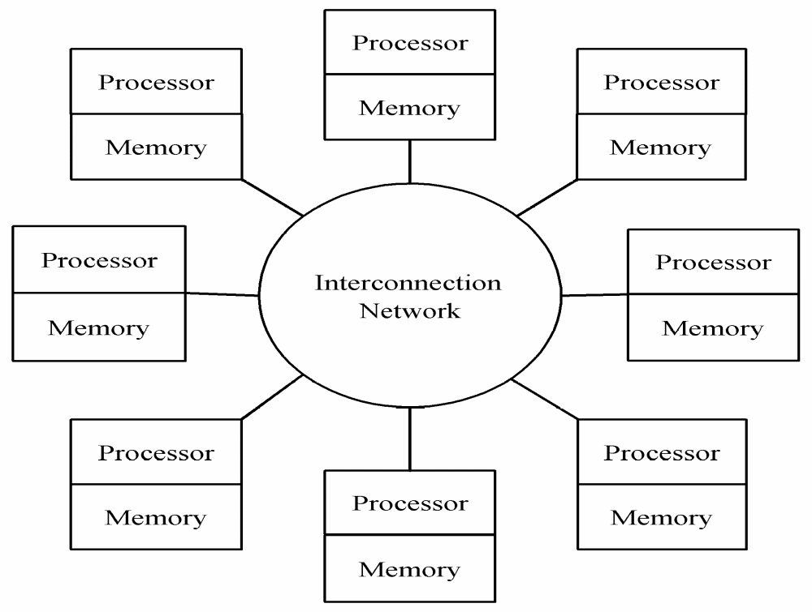
Message-passing Model

Slide 6
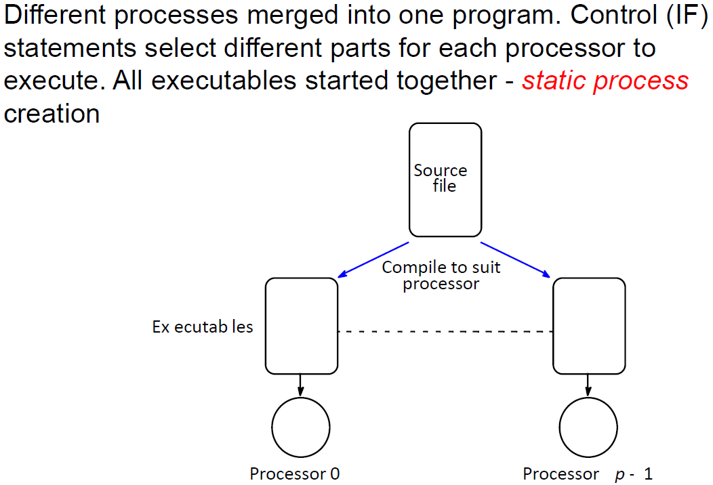
Single Program Multiple Data (SPMD)

Slide 7
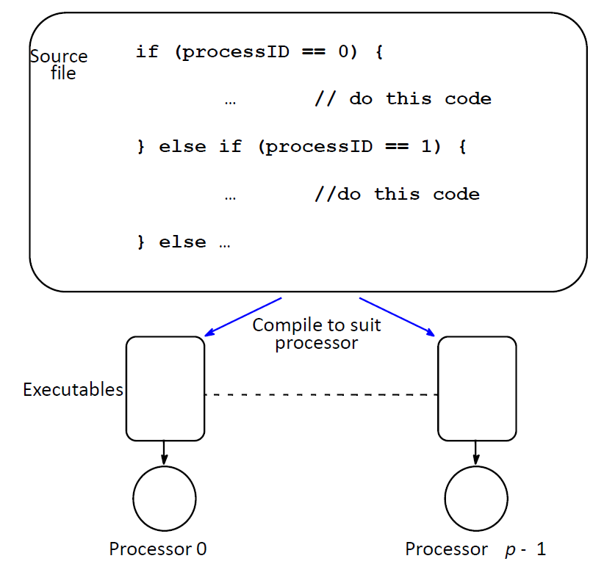
Single Program Multiple Data (SPMD)

Slide 8
Processes
Number is specified at start-up time
Remains constant throughout execution of program
All execute same program
Each has unique ID number
Alternately performs computations and communicates

Slide 9
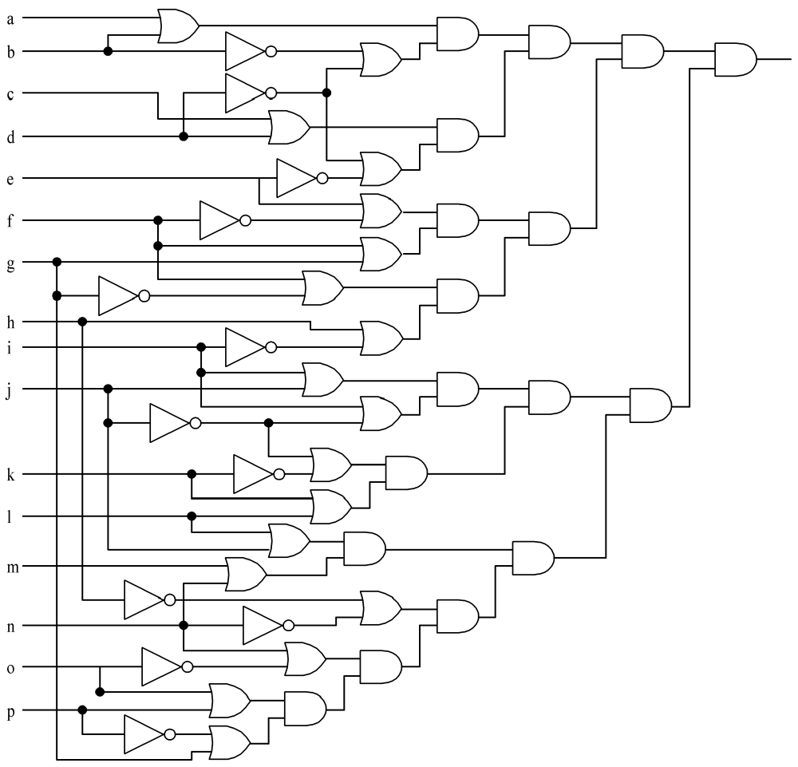
An Example: Circuit Satisfiability
1
1
0
1
1
1
Not satisfied
1
1
1
1
1
1
1
1
1
1
1

Slide 10
Solution Method
Circuit satisfiability is NP-complete
No known algorithms to solve in polynomial time
We seek all solutions
We find through exhaustive search
16 inputs ⇒ 65,536 combinations to test

Slide 11
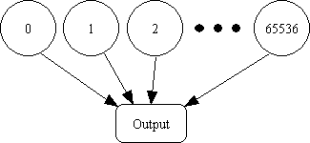
Partitioning: Functional Decomposition
Embarrassingly parallel: No channels between tasks

Slide 12
Agglomeration and Mapping
Properties of parallel algorithm
  Fixed number of tasks
  No communications between tasks
  Time needed per task is variable
Consult mapping strategy decision tree
  Map tasks to processors in a cyclic fashion

Slide 13
Cyclic (interleaved) Allocation
Assume p processes
Each process gets every p^{th} piece of work
Example: 5 processes and 12 pieces of work
  P₀: 0, 5, 10
  P₁: 1, 6, 11
  P₂: 2, 7
  P₃: 3, 8
  P₄: 4, 9

Slide 14
Pop Quiz
Assume n pieces of work, p processes, and cyclic allocation
What is the most pieces of work any process has?
What is the least pieces of work any process has?
How many processes have the most pieces of work?

Slide 15
Summary of Program Design
Program will consider all 65,536 combinations of 16 boolean inputs
Combinations allocated in cyclic fashion to processes
Each process examines each of its combinations
If it finds a satisfiable combination, it will print it

Slide 16
Include Files
#include <mpi.h>
MPI header file
#include <stdio.h>
Standard I/O header file

Slide 17
Local Variables
int main (int argc, char *argv[]) {
int i;
int id; /* Process rank */
int p; /* Number of processes */
void check_circuit (int, int);
Include argc and argv: they are needed to initialize MPI
One copy of every variable for each process running this program

Slide 18
Initialize MPI
MPI_Init (&argc, &argv);
First MPI function called by each process
Not necessarily first executable statement
Allows system to do any necessary setup

Slide 19
Communicators
Communicator: opaque object that provides message-passing environment for processes
MPI_COMM_WORLD
  Default communicator
  Includes all processes
Possible to create new communicators
  Will do this in Chapters 8 and 9

Slide 20
Communicator
Communicator Name
Communicator
MPI_COMM_WORLD
Processes
0
5
Ranks
2
1
4
3

Slide 21
Determine Number of Processes
MPI_Comm_size (MPI_COMM_WORLD, &p);
First argument is communicator
Number of processes returned through second argument

Slide 22
Determine Process Rank
MPI_Comm_rank (MPI_COMM_WORLD, &id);
First argument is communicator
Process rank (in range 0, 1, …, p-1) returned through second argument

Slide 23
Replication of Automatic Variables
id
1
id
0
p
6
p
6
id
5
id
2
p
6
id
4
6
p
id
3
p
6
p
6

Slide 24
What about External Variables?
int total;
int main (int argc, char *argv[]) {
int i;
int id;
int p;
…

Slide 25
Cyclic Allocation of Work
for (i = id; i < 65536; i += p)
check_circuit (id, i);
Parallelism is outside function check_circuit
It can be an ordinary, sequential function

Slide 26
Shutting Down MPI
MPI_Finalize();
Call after all other MPI library calls
Allows system to free up MPI resources

Slide 27
#include <mpi.h>
#include <stdio.h>
int main (int argc, char *argv[]) {
int i;
int id;
int p;
void check_circuit (int, int);
MPI_Init (&argc, &argv);
MPI_Comm_rank (MPI_COMM_WORLD, &id);
MPI_Comm_size (MPI_COMM_WORLD, &p);
for (i = id; i < 65536; i += p)
check_circuit (id, i);
printf ("Process %d is done\n", id);
fflush (stdout);
MPI_Finalize();
return 0;
}
Put fflush() after every printf()

Slide 28
/* Return 1 if 'i'th bit of 'n' is 1; 0 otherwise */
#define EXTRACT_BIT(n,i) ((n&(1<<i))?1:0)
void check_circuit (int id, int z) {
int v[16]; /* Each element is a bit of z */
int i;
for (i = 0; i < 16; i++) v[i] = EXTRACT_BIT(z,i);
if ((v[0] || v[1]) && (!v[1] || !v[3]) && (v[2] || v[3])
&& (!v[3] || !v[4]) && (v[4] || !v[5])
&& (v[5] || !v[6]) && (v[5] || v[6])
&& (v[6] || !v[15]) && (v[7] || !v[8])
&& (!v[7] || !v[13]) && (v[8] || v[9])
&& (v[8] || !v[9]) && (!v[9] || !v[10])
&& (v[9] || v[11]) && (v[10] || v[11])
&& (v[12] || v[13]) && (v[13] || !v[14])
&& (v[14] || v[15])) {
printf ("%d) %d%d%d%d%d%d%d%d%d%d%d%d%d%d%d%d\n", id,
v[0],v[1],v[2],v[3],v[4],v[5],v[6],v[7],v[8],v[9],
v[10],v[11],v[12],v[13],v[14],v[15]);
fflush (stdout);
}
}

Slide 29
Compiling/executing (SPMD) MPI program
To compile MPI programs:
for C mpicc -o prog prog.c
for C++ mpiCC -o prog prog.cpp
To execute MPI program:
mpiexec –v -np no_procs prog
verbose mode if desired
A positive integer

Slide 30
Executing MPI program on multiple computers: Interactive Mode
Create a file called say “hosts” containing the list of machines:
node1 slots=2
node2 slots=2
node3 slots=4
node4 slots=4

Slide 31
mpiexec -np 100 --hostfile hosts prog
would run prog with one hundred processes on four computers.
Each processes would execute on one of machines in list. MPI would cycle through list of machines giving processes to machines.

Slide 32
Questions?
Two popular MPI implementation
OPEN MPI: http://www.open-mpi.org/faq/
MPICH2: http://www.mcs.anl.gov/research/projects/mpich2/

Slide 33
Enabling Remote Logins
MPI needs to be able to initiate processes on other processors without supplying a password
Each processor in group must list all other processors in its .ssh/known_hosts file; e.g.,
  node1, 138.67.22.55 ssh-rsa AAAAB3Nza…..
  .
  .
  Manually log in and type your passwd for the first time,
  then passwd is automatically stored

Slide 34
Execution on 1 CPU
% mpiexec -np 1 --hostfile hosts sat
0) 1010111110011001
0) 0110111110011001
0) 1110111110011001
0) 1010111111011001
0) 0110111111011001
0) 1110111111011001
0) 1010111110111001
0) 0110111110111001
0) 1110111110111001
Process 0 is done

Slide 35
Execution on 2 CPUs
% mpiexec -np 2 --hostfile hosts sat
0) 0110111110011001
0) 0110111111011001
0) 0110111110111001
1) 1010111110011001
1) 1110111110011001
1) 1010111111011001
1) 1110111111011001
1) 1010111110111001
1) 1110111110111001
Process 0 is done
Process 1 is done

Slide 36
Execution on 3 CPUs
% mpiexec -np 3 --hostfile hosts sat
0) 0110111110011001
0) 1110111111011001
2) 1010111110011001
1) 1110111110011001
1) 1010111111011001
1) 0110111110111001
0) 1010111110111001
2) 0110111111011001
2) 1110111110111001
Process 1 is done
Process 2 is done
Process 0 is done

Slide 37
Deciphering Output
Output order only partially reflects order of output events inside parallel computer
If process A prints two messages, first message will appear before second
If process A calls printf before process B, there is no guarantee process A’s message will appear before process B’s message

Slide 38
Enhancing the Program
We want to find total number of solutions
Incorporate sum-reduction into program
Reduction is a collective communication

Slide 39
Modifications
Modify function check_circuit
  Return 1 if circuit satisfiable with input combination
  Return 0 otherwise
Each process keeps local count of satisfiable circuits it has found
Perform reduction after for loop

Slide 40
New Declarations and Code
int count; /* Local sum */
int global_count; /* Global sum */
int check_circuit (int, int);
count = 0;
for (i = id; i < 65536; i += p)
count += check_circuit (id, i);

Slide 41
Prototype of MPI_Reduce()
int MPI_Reduce (
void *operand,
/* addr of 1st reduction element */
void *result,
/* addr of 1st reduction result */
int count,
/* reductions to perform */
MPI_Datatype type,
/* type of elements */
MPI_Op operator,
/* reduction operator */
int root,
/* process getting result(s) */
MPI_Comm comm
/* communicator */
)

Slide 42
MPI_Datatype Options
MPI_CHAR
MPI_DOUBLE
MPI_FLOAT
MPI_INT
MPI_LONG
MPI_LONG_DOUBLE
MPI_SHORT
MPI_UNSIGNED_CHAR
MPI_UNSIGNED
MPI_UNSIGNED_LONG
MPI_UNSIGNED_SHORT

Slide 43
MPI_Op Options
MPI_BAND
MPI_BOR
MPI_BXOR
MPI_LAND
MPI_LOR
MPI_LXOR
MPI_MAX
MPI_MAXLOC
MPI_MIN
MPI_MINLOC
MPI_PROD
MPI_SUM

Slide 44
Our Call to MPI_Reduce()
MPI_Reduce (&count,
&global_count,
1,
MPI_INT,
MPI_SUM,
0,
MPI_COMM_WORLD);
Only process 0
will get the result
if (!id) printf ("There are %d different solutions\n",
global_count);

Slide 45
Execution of Second Program
% mpiexec -np 3 seq2
0) 0110111110011001
0) 1110111111011001
1) 1110111110011001
1) 1010111111011001
2) 1010111110011001
2) 0110111111011001
2) 1110111110111001
1) 0110111110111001
0) 1010111110111001
Process 1 is done
Process 2 is done
Process 0 is done
There are 9 different solutions

Slide 46
Benchmarking the Program
MPI_Barrier ⎯ barrier synchronization
MPI_Wtick ⎯ timer resolution
MPI_Wtime ⎯ current time

Slide 47
Benchmarking Code
double elapsed_time;
…
MPI_Init (&argc, &argv);
MPI_Barrier (MPI_COMM_WORLD);
elapsed_time = - MPI_Wtime();
…
MPI_Reduce (…);
elapsed_time += MPI_Wtime();
/*finding max time for all processes*/
MPI_Reduce (…);

Slide 48
Benchmarking Results
Processors | Time (sec)
1 | 15.93
2 | 8.38
3 | 5.86
4 | 4.60
5 | 3.77

Slide 49
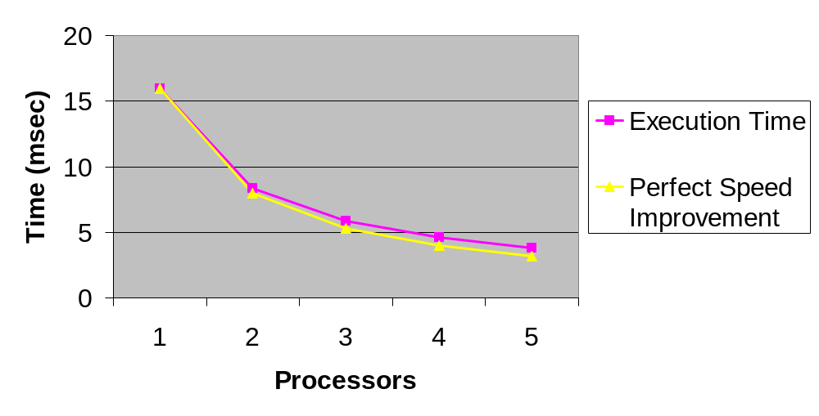
Benchmarking Results

Slide 50
Summary (1/2)
Message-passing programming follows naturally from task/channel model
Portability of message-passing programs
MPI most widely adopted standard

Slide 51
Summary (2/2)
MPI functions introduced
  MPI_Init
  MPI_Comm_rank
  MPI_Comm_size
  MPI_Reduce
  MPI_Finalize
  MPI_Barrier
  MPI_Wtime
  MPI_Wtick

Slide 52
Executing MPI program on Large Supercomputers: Job Scheduler
In this class, we will study and use a more serious job execution/scheduling approach that are widely used in major large supercomputers in the world:
http://www.cs.ucr.edu/~pwu011/tardis.html

